Slide 1
Overview

Slide 2

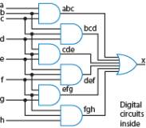
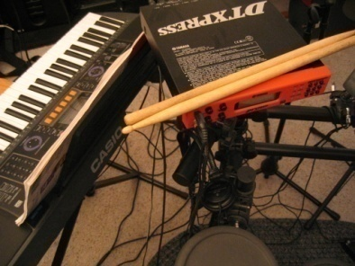

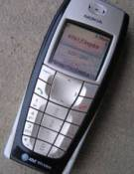
Why Study Digital Design?
Look “under the hood” of computers
Solid understanding --> confidence, insight, even better programmer when aware of hardware resource issues
Electronic devices becoming digital
Enables:
Better devices: Sound recorders, cameras, cars, cell phones, medical devices,...
New devices: Video games, PDAs, ...
Known as “embedded systems”
Thousands of new devices every year
Designers needed
Satellites
DVD
Video
Musical
Portable
players
recorders
instruments
music players
Cell phones
Cameras
TVs
???
1995
1997
1999
2001
2003
2005
2007

Slide 3
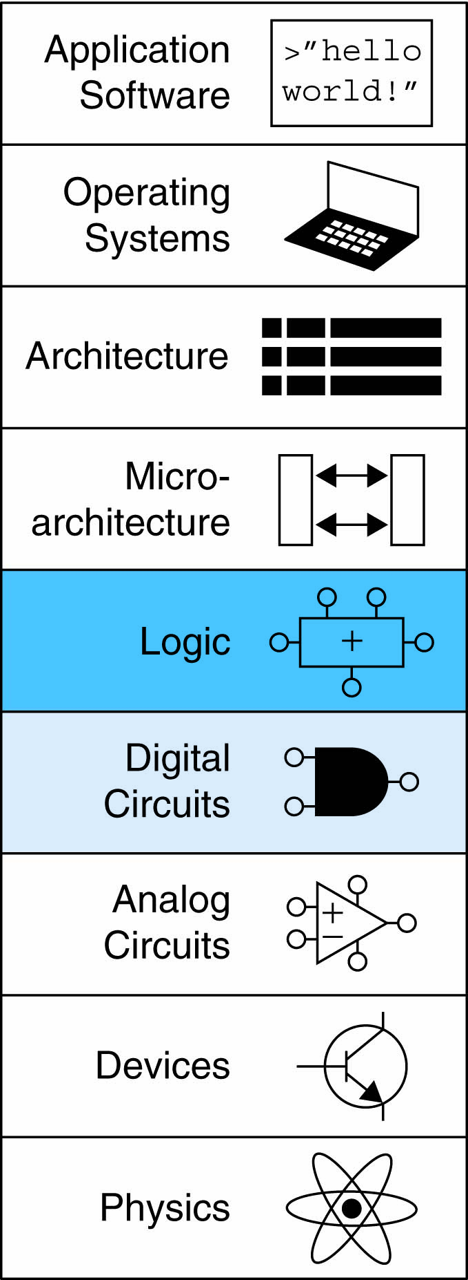
Theory & Practice
Abstraction
Analysis & design of digital electronic circuits
Fundamental concepts in the design of digital systems
Basic tools for the design of digital circuits

Slide 4
Computer Engineering
concentrate more on the computational process at an abstract level as opposed to how the computation is accomplished with metal and silicon (wires and transistors).
views a computing system in terms of what it can do rather than how.
They often employ sophisticated abstract mathematical or logic-based models of computing systems as way to understand their capabilities.

Slide 5
Combinational Circuits
Outputs depend solely on the present combination of the circuit inputs’ values
b=0
Digital
F=0
Motion
a
System
sensor
Digital
System
F
Lamp
Light
b
b=1
Digital
F=1
sensor
System
if a=0 and b=0, then F=0
if b=0, then F=0
if a=0 and b=1, then F=0
if b=1, then F=1
if a=1 and b=0, then F=1
if a=1 and b=1, then F=0

Slide 6
Sequential Circuits
Has “memory” that impacts outputs too
Output depends not just on present inputs (as in combinational circuit), but on past sequence of inputs
Stores bits, also known as having “state”
1
b=0
Digital
F=0
a
1
0
Combinational
digital circuit
F
System
b
b=1
Digital
F=1
1
System
a
Sequential
digital circuit
?
0
F
b
b=0
Digital
F=1
System
Must know sequence of past inputs to know output
Cannot dete
r
mine
v
alue of
F solely from present
input value

Slide 7
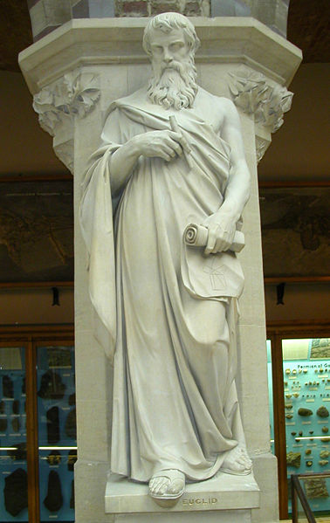
Egeli matematikçi Öklid (M.Ö. 325 - M.Ö. 265)
Dönemin kralı I. Ptolemy , okumada güçlük çektiği Elementler'in yazarına, “Geometriyi kestirmeden öğrenmenin yolu yok mu?” diye sorduğunda, Öklid “Özür dilerim, ama geometriye giden bir kral yolu yoktur” der.
Bir gün dersini bitirdiğinde öğrencilerinden biri yaklaşır, ”Hocam, verdiğiniz ispatlar çok güzel; ama pratikte bunlar neye yarar?” diye sorduğunda, Öklid kapıda bekleyen kölesini çağırır, “Bu delikanlıya 5-10 kuruş ver, vaktinin boşa gitmediğini görsün!” demekle yetinir .

Slide 8
Franz Kafka – En Yakın Köy
Dedem söyleyip dururdu:
“Hayat inanılmaz derecede kısadır. Şimdi hatıralarımı derleyip topladığımda örneğin, aklım şunu güç bela alıyor, genç bir adam, talihsiz rastlantıları hesaba katmaksızın olağan bir zamanda böyle bir gezinti için hayatın mutlu mesut akışı bile kesinlikle yetmezken, en yakın köye korkmadan at sürmeye nasıl karar verebilir.”

